Slide 1
GSM Based Real Time Health Monitoring System using Arduino

Slide 2
Introduction
Recently, the health care sensors are playing a vital role in hospitals. The patient monitoring systems is one of the major improvements because of its advanced technology. So our project essentially entails connecting the temperature sensor and heartbeat sensor with the Arduino Uno so that simultaneously one can monitor the patient’s condition and hence ruling out the use of the thermometer and other devices to check the condition of the patient.

Slide 3
PROBLEM STATEMENT
The current systems for this monitoring are prohibitively expensive, they are only found in certain hospitals, leave alone homes. This project will partly solve this problem.
Systems used in hospitals are also complex that only certain people can understand them. The current systems also require one to be around to check the condition of the patient

Slide 4
Features
The function of this system is thus to monitor the temperature and Heart Beat of the Patient and the data collected by the sensors are sent to the Arduino Uno. The Arduino processes then transmits the data over the air via GSM shield to a doctor’s, nurse’s or a relative’s phone and also displays the same information on a LCD.

Slide 5
Working flow of our system
Start
YES
Send Info
Input From User
Send SMS
NO
Data Read From Sensor
YES
Call Alert
Data Processing & Calculation
Call In Register Number
NO
Display Data
END

Slide 6
OBJECJECTIVES
Main objective
To develop a cheap prototype of a system that can monitor the body temperature and heartbeat of a patient at home and in the hospital.
Specific objectives
To use temperature sensor to measure body temperature
To use heartbeat temperature to measure rate of heartbeat
Compute the two signals then display to a LCD and send to mobile phone as a SMS.
To alert through text when there is an abnormal parameter

Slide 7
ADVANTAGES:
It is highly accurate and precise and also very reliable.
It helps in faster detection of input sensors
It will reduce the extra consumption of electricity
It is portable and hence can be placed anywhere.
The use of a microcontroller increases its scope of applications and modifications.
The microcontroller can be reprogrammed if any modification is required.
DISADVANTAGES:
The sensors are costly
If power supply fails circuit won’t work

Slide 8
APPLICATIONS
Heart rate monitor can be used in hospitals for the diagnostic purposes.
Since the instrument is not expensive, it can even be used at home.
The other part of the instrument ,which measures the temperature can also be used in hospitals for diagnostic purpose.
The instrument can also be integrated with higher level equipment and used in various applications.

Slide 9
Component Overview

Slide 10
Necessary Components
Hardware Specifications
Arduino Uno - R3
LCD Display
pulse sensor sen-11574
Temperature Sensor (DS18B20)
GSM Module SIM 900A
Buzzer
Resistors
Potentiometer
Software Specifications
Arduino Compiler
MC Programming Language: Embedded C

Slide 11
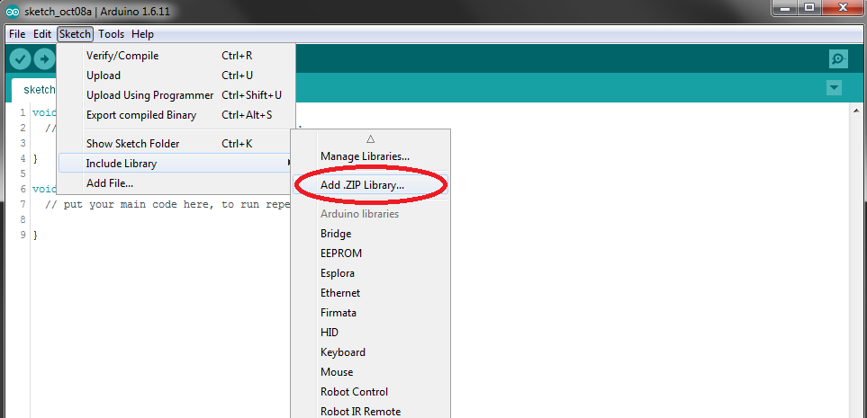
Necessary Library & Import library
#include <SoftwareSerial.h>
#include <OneWire.h>
#include <DallasTemperature.h>
#include <LiquidCrystal.h>

Slide 12
components description

Slide 13
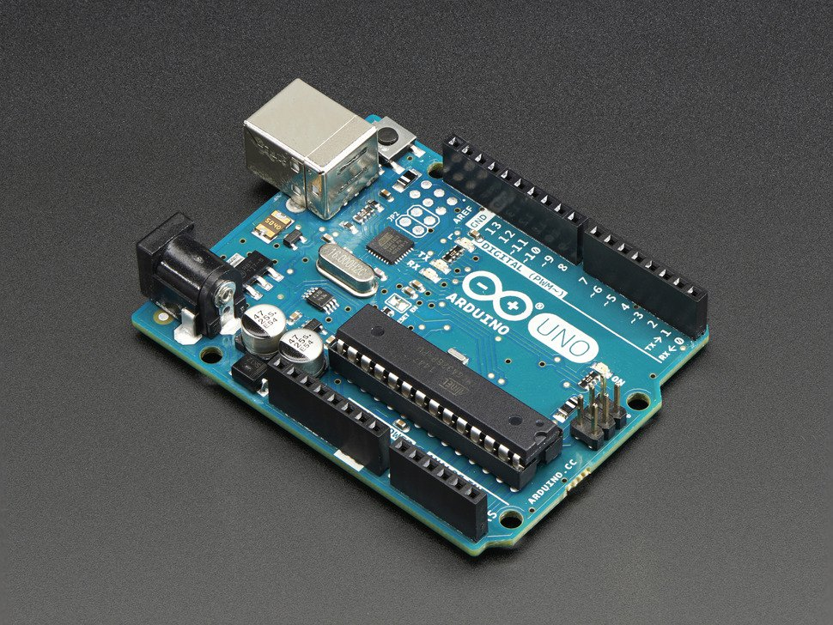
Arduino Uno - R3
Features:
Microcontroller | ATmega328
Operating Voltage | 5V
Input Voltage (recommended) | 7-12V
Input Voltage (limits) | 6-20V
Digital I/O Pins | 14 (of which 6 provide PWM )
Analog Input Pins | 6
DC Current per I/O Pin | 40 mA
DC Current for 3.3V Pin | 50 mA
Flash Memory | 32 KB (ATmega328)
SRAM | 2 KB (ATmega328)
EEPROM | 1 KB (ATmega328)
Clock Speed | 16 MHz

Slide 14
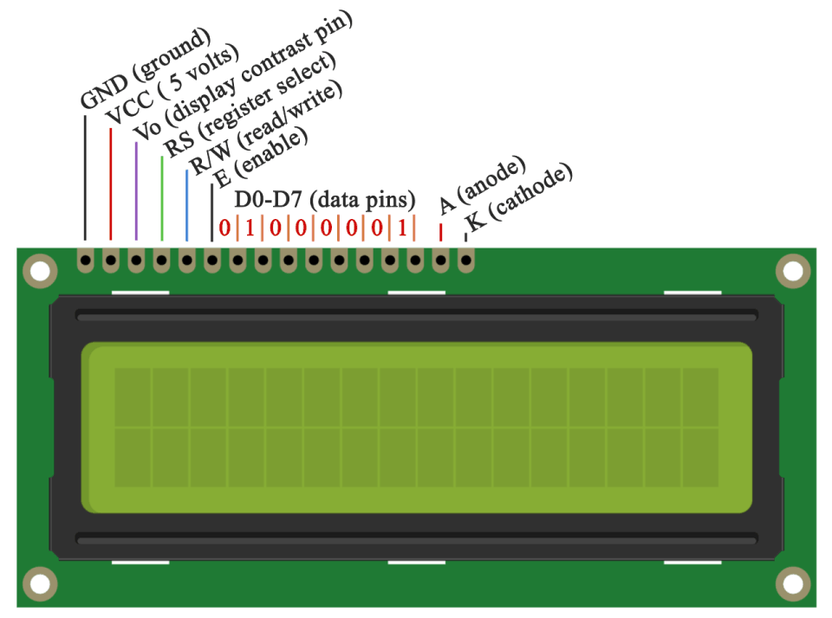
LCD Display
LCD (Liquid Crystal Display) screen is an electronic display module and find a wide range of applications. A 16x2 LCD display is very basic module and is very commonly used in various devices and circuits. These modules are preferred over seven segments and other multi segment LED s. The reasons being: LCDs are economical; easily programmable

Slide 15
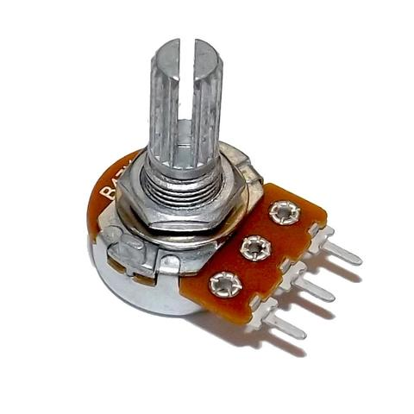
POTENTIOMETER:
A potentiometer (colloquially known as a "pot") is a three-terminal resistor with a sliding contact that forms an adjustable voltage divider.[1] If only two terminals are used (one side and the wiper), it acts as a variable resistor or rheostat. Potentiometers are commonly used to control electrical devices

Slide 16
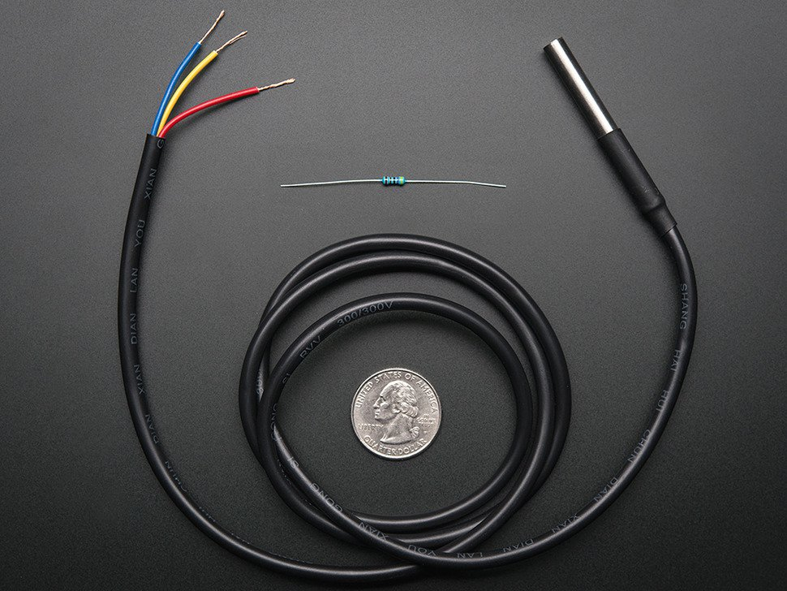
Temperature Sensor (DS18B20)
Usable temperature range: -55 to 125°C (-67°F to +257°F)
9 to 12 bit selectable resolution
Uses 1-Wire interface- requires only one digital pin for communication
Unique 64 bit ID burned into chip
Multiple sensors can share one pin±0.5°C Accuracy from -10°C to +85°C

Slide 17
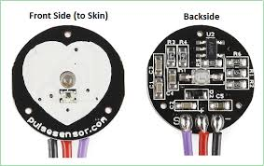
pulse sensor sen-11574
Kit Includes:
Pulse Sensor Board
24-inch Color-Coded Cable with Standard Male Headers.
Transparent Stickers to Protect Sensor.

Slide 18
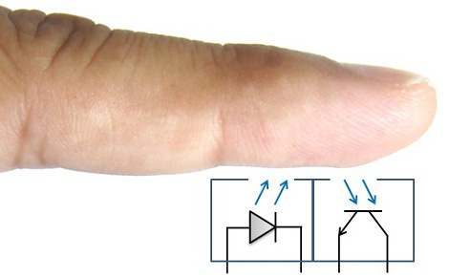
HOW ? ? ?
The sensor itself consists of an infrared emitter and detector mounted side-by-side and pressed closely against the skin.
When the heart pumps, blood pressure rises sharply, and so does the amount of infrared light from the emitter that gets reflected back to the detector.

Slide 19
The detector passes more current when it receives more light, which in turn causes a voltage drop to enter the amplifier circuitry.
This design uses two consecutive operational amplifiers (“op-amps”) to establish a steady baseline for the signal, emphasize the peaks, and filter out noise.
Both op-amps are contained in a single integrated circuit (IC or “chip”),

Slide 20
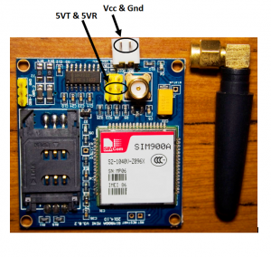
GSM Module SIM 900A
This is an international standard for mobile communication which in full is Global System for Mobile communications. It also referred to as 2G, which is second generation cellular network.
GSM supports outgoing and incoming voice calls, Simple Message System, and data communication via GPRS among others.

Slide 21
BLOCK DIAGRAM OF THE SYSTEM

Slide 22
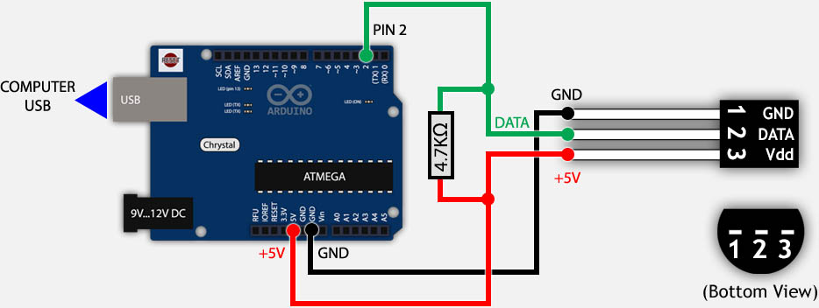
Interfacing DS18B20 with Arduino

Slide 23
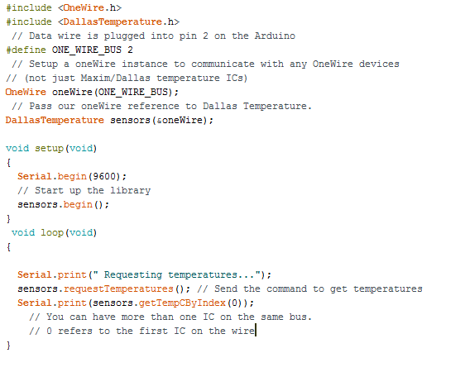
Working Principle

Slide 24
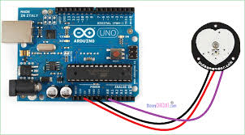
Interfacing Pulse sensor with Arduino

Slide 25

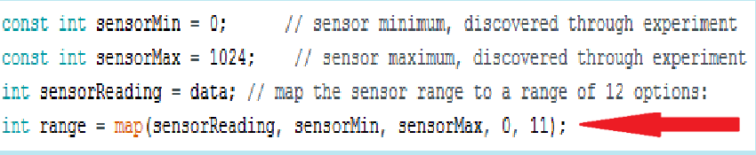
Working Principle
Read Analog Input
Map the reading

Slide 26
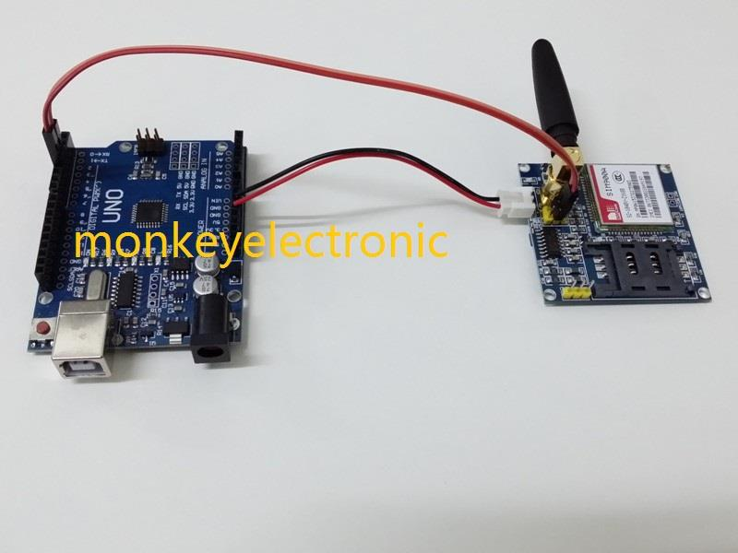

Interfacing-SIM900A-GSM-Modem-with-Arduino
Define Rx and Tx :
Establish connection

Slide 27
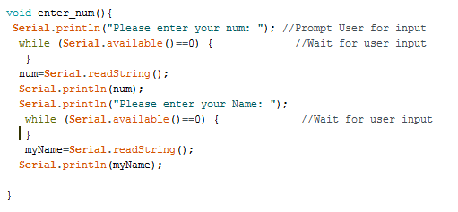
Working Principle
Set threshold value for temp :
Set Patient name & Destination phone num :

Slide 28
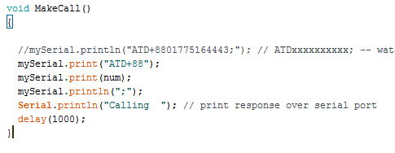
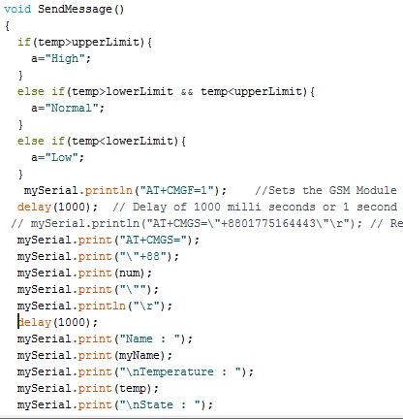
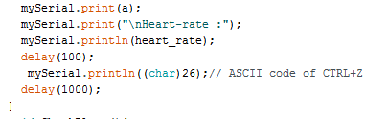
Working Principle
Make a call
Send message

Slide 29
Project View and Result

Slide 30
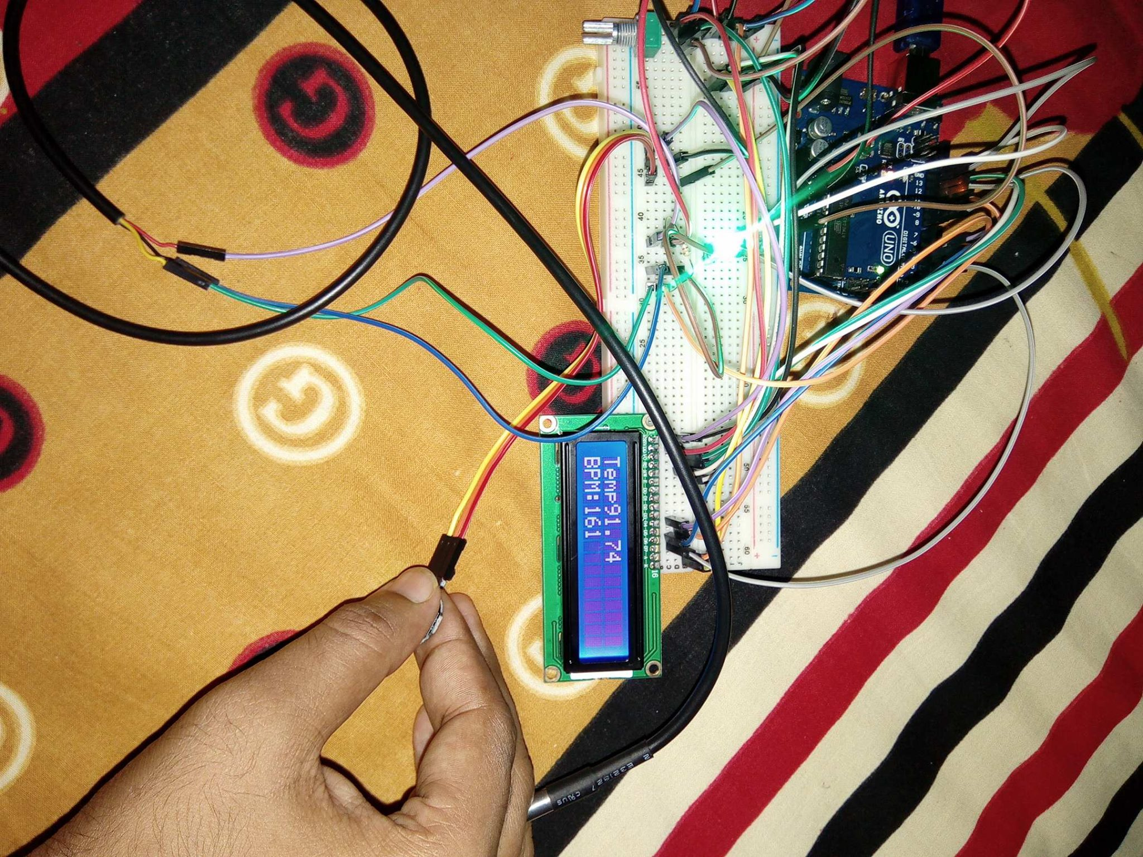
Top view

Slide 31
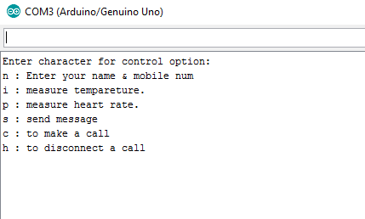
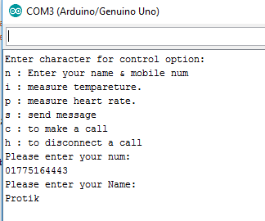
Output
All menu :
Enter Name & Destination mobile number :

Slide 32
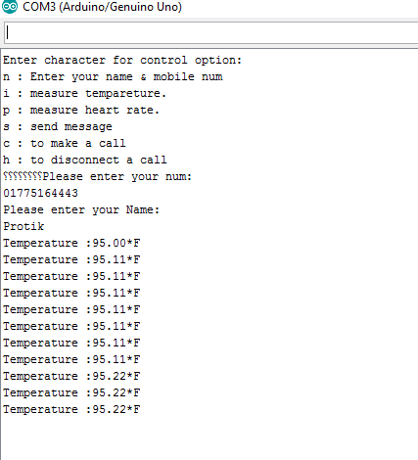
Measure Temp

Slide 33
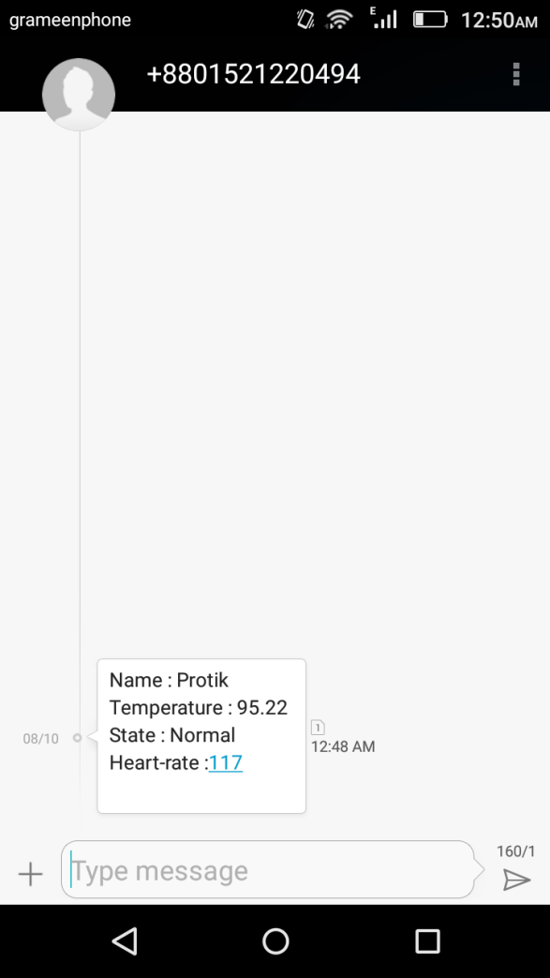
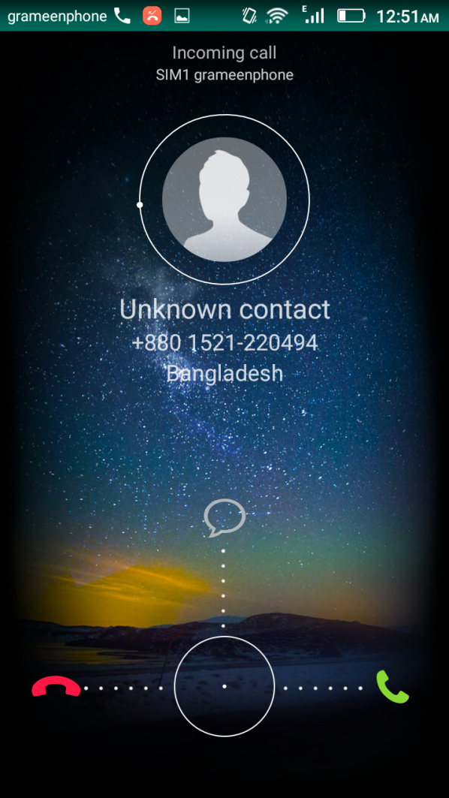
SMS and call
Health Report Call Destination num :

Slide 34
Future work
This project can be implemented using IOT – Internet of things. By doing this, we can send this data to the Internet.
We can add the module of voice alarm system to indicate parameters crossing the threshold value.

